Slide 1



Customer Churn Analysis
View in Power BI
Last data refresh:
2024-02-17 12:21:47 AM UTC
Downloaded at:
2024-02-17 1:25:11 AM UTC

Slide 2
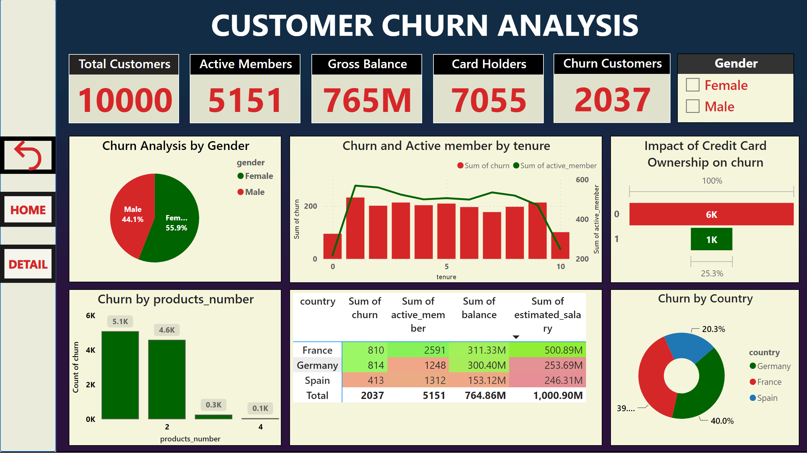
Dashboard
Notes:
Total Customers
No alt text provided
textbox
No alt text provided
Active Members
No alt text provided
Gross Balance
No alt text provided
Card Holders
No alt text provided
Churn Customers
No alt text provided
shape
No alt text provided
Churn Analysis by Gender
No alt text provided
Churn by products_number
No alt text provided
Impact of Credit Card Ownership on churn
No alt text provided
Churn and Active member by tenure
No alt text provided
Churn by Country
No alt text provided
pivotTable
No alt text provided
actionButton
No alt text provided
actionButton
No alt text provided
actionButton
No alt text provided
Gender
No alt text provided

Slide 3
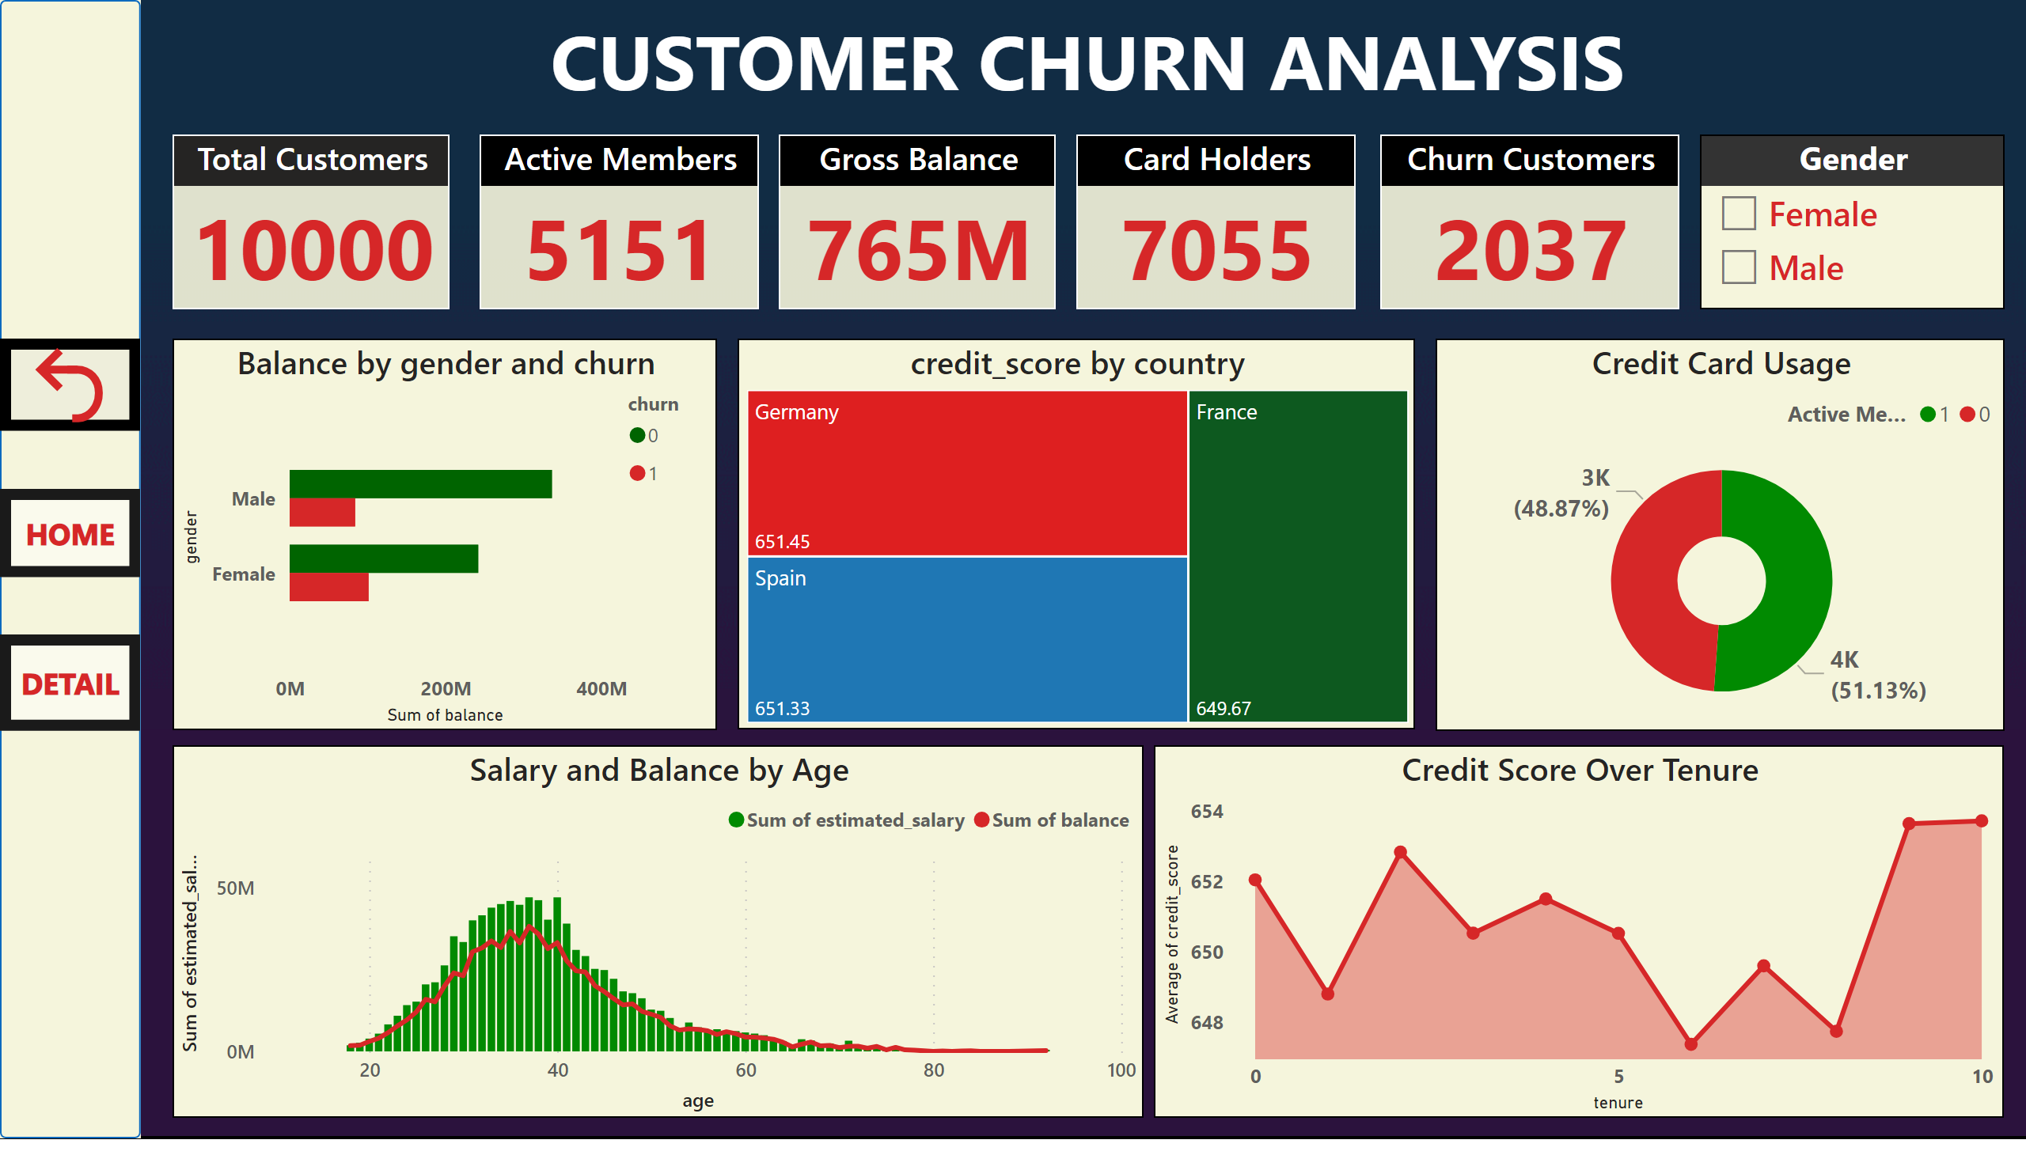
Detail Analysis
Notes:
textbox
No alt text provided
shape
No alt text provided
Credit Score Over Tenure
No alt text provided
credit_score by country
No alt text provided
Credit Card Usage
No alt text provided
Salary and Balance by Age
No alt text provided
Balance by gender and churn
No alt text provided
actionButton
No alt text provided
actionButton
No alt text provided
actionButton
No alt text provided
Total Customers
No alt text provided
Active Members
No alt text provided
Gross Balance
No alt text provided
Card Holders
No alt text provided
Churn Customers
No alt text provided
Gender
No alt text provided

Slide 4
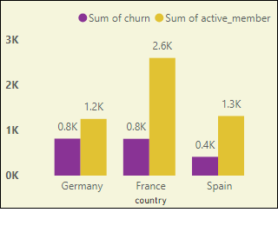
Tootltip
Notes:
clusteredColumnChart
No alt text provided

